Slide 1

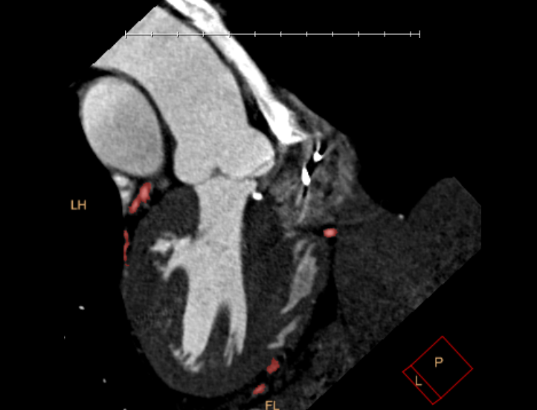
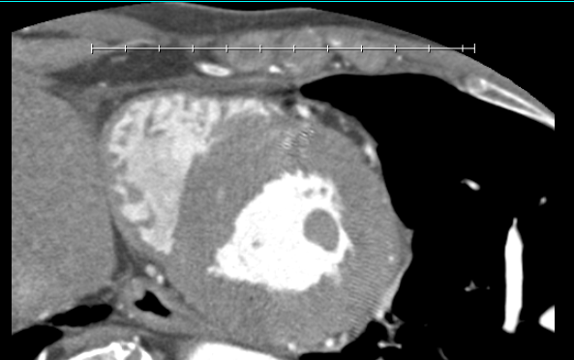
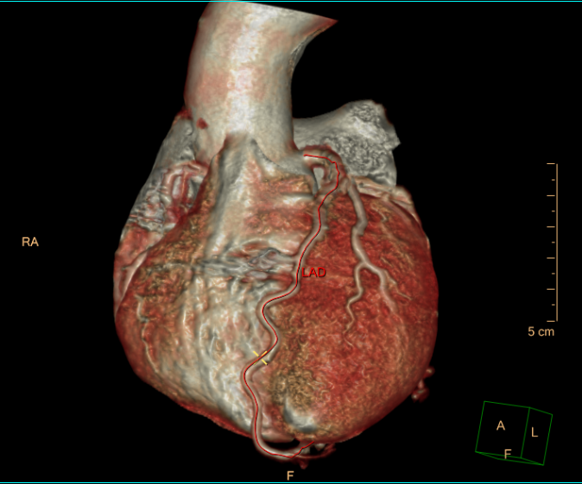
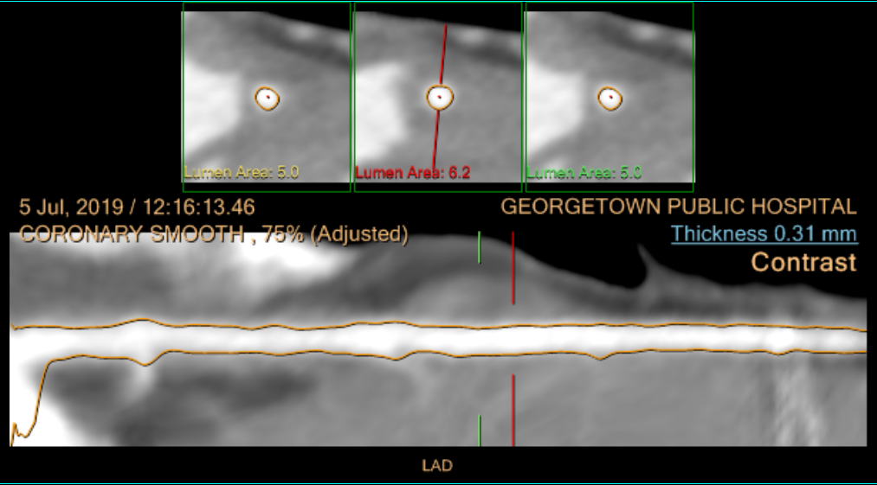
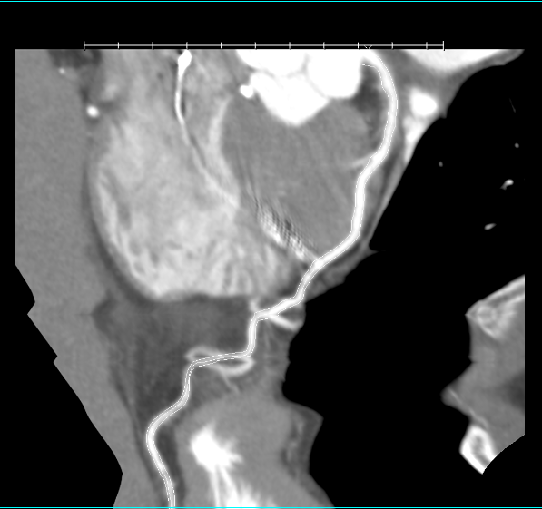
First Cardiac CT in Guyana
Dr Joel Joseph
Georgetown Public Hospital Corporation, Radiology
purpose
Methodology
Results
To document circumstances under which the cardiac CT service was started at the Georgetown Public Hospital Corporation and the challenges faced in acquiring the first diagnostic quality images.
Team members
  Technologists-
    Ms Basmattie Sawh B. Sc MIT, and others.
  Radiologists-
    Dr. Jonathan Vaccaro, Rad-Aid volunteeer attending radiologist
    Dr Joel Joseph- 2nd year resident radiologist
Equipment
  Philips Ingenuity 64 detector CT scanner.
  Philips Intellispace portal 8.0.
  Medrad dual head contrast injector
Procedure
  500mcg GTN, 5mg Metropol IV
  100 ml of Ultravist 300 injected at 5.5ml/s.
  Heart rate 65 beats per minute in sinus rhythm
  Gated CTA was performed from the level of the ascending aorta to the costodiaphragmatic sulci.
Image Quality
Background
Good opacification with no significant motion.
Coronary artery disease is a top cause of mortality.
PCI reduces morbidity and mortality of acute M.I.
Open heart surgery is done for extensive or complex stenosis found on angiography.
Clinical M.I.= irreversible loss of myocardium.
CARDIAC CT can detect stenosis before M.I. !
A 64 detector CT was purchased by the Georgetown Public Hospital Corporation (GPHC) and came into use there in May of 2018.
First Cardiac CT was completed by technologists at GPHC on the 5th of July 2019 directed by a resident radiologist.
Reformats
Segmentation and volume rendering, straight planar and curved planar reformats.
How it works
Discussion
& conclusions
Cardiac Gating
Requires high temporal resolution- fast scan speed.
Segmentation
MPR, straight planar and curved planar
Results
Cardiac CT in developed countries requires separate training and certification.
However, good image quality was achieved at GPHC without special cardiac imaging training.
Further training and certification may be useful to maintain quality and safety standards.
Radiation dose
33.9 mSv over two scans.
The calcium scoring accounted for only 1.1mSv of the total dose.
Requires high temporal resolution- fast scan speed;
64 MDCT minimum requirement
Cardiac CT software package.
Radiologists
Technologists

